Slide 1

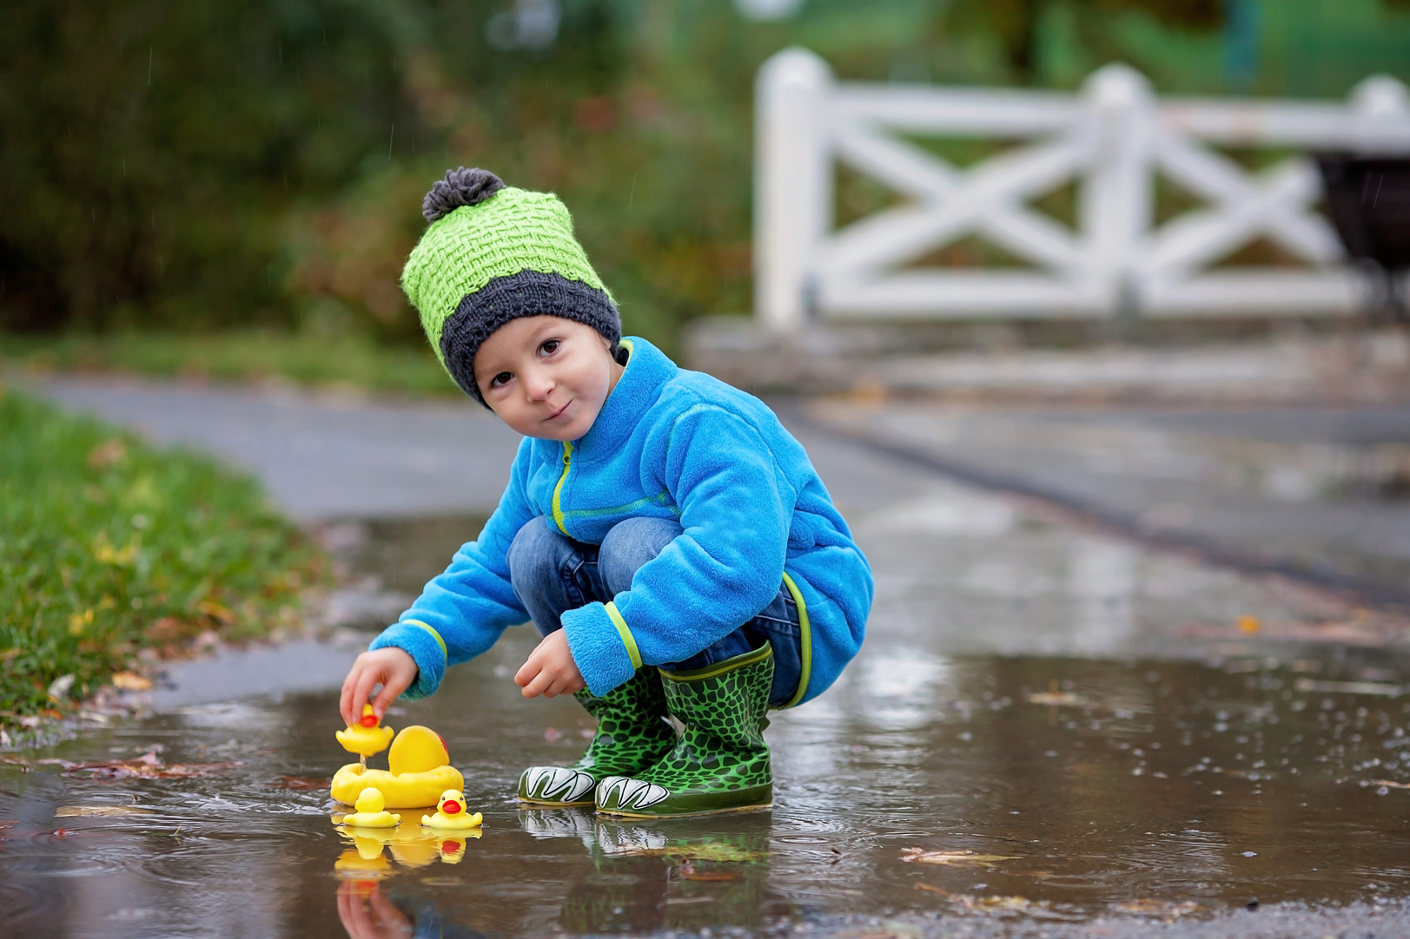





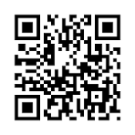


Help us protect
kids from
pneumonia
Join the Finding Pneumo study as a healthy control
Who can take part?
  Healthy children aged 13 months to less than 5 years.
What is involved?
  One-off urine sample
  One-off nose swab
  Short survey covering health, background, and vaccination history
Why participate?
  Help researchers compare children with and without pneumonia.
  Improve understanding of which pneumococcal bacteria are currently causing pneumonia in children.
  Support the development of new vaccines to provide the best protection.
Participant support:
  A gift card voucher upon study completion.
Interested?
  Scan this QR code
  Contact the MCRI study team
Studyteam@MCRI.edu.au
9333 3333
Finding Pneumo Study RCH Flyer V1, 16Oct2026, HREC# 128926
Flyer produced by Abigail Fernando and Annette Alafaci

